Slide 1
Operating Systems and Network Concepts
Process
Results

Slide 2
Course Objectives
To understand the Operating System basics
Hardware, Software, Memory management and Process management
To understand the basics of Computer Networks
Protocols, IP addresses

Slide 3
Session Plan
Computer Systems
Hardware and Software
Components of a Computer Systems
Operating Systems
Processes & Process Management
Memory & Memory Management
Compiler and Interpreter
Networks
Protocols
System Computing
Malicious code – Virus, Worms, Trojan horse

Slide 4

Ice Breaker
Imagine that you have a copy of the book Tom Sawyer. You tear it to pieces and push the shreds through your garbage disposal. (It was probably assigned reading.) Have you destroyed the novel Tom Sawyer?

Slide 5

Introduction to Computer Systems
A computer is a complex system consisting of both hardware and software components.
Lets us start the discussion from these components.

Slide 6

Hardware and Software
In thinking about a movie you are thinking about information, not about something physical.
When you speak of a movie , It is intangible
If We talk about DVD, projector ,Camera It is Tangible
The word hardware is used for physical devices such as Camera, DVD players and computers.
The word software is used for the information used with such devices: movies, music, web pages, computer programs, and data.
When talking about computer systems, It is the combination of Hardware and software
Hardware means the physical parts of the computer. Software means the programs and data used with the physical computer.

Slide 7
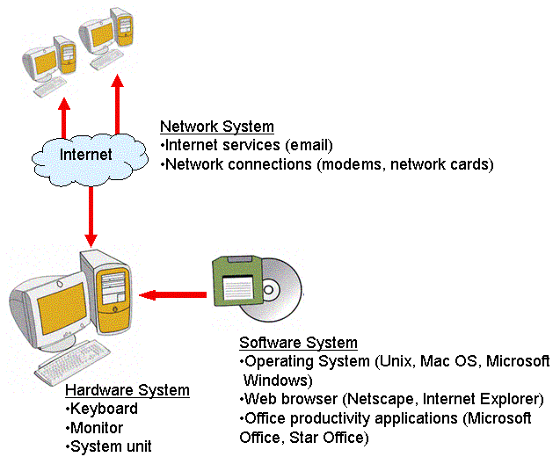
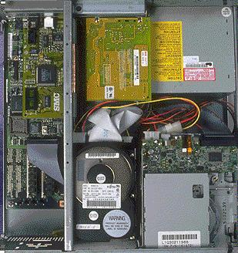
Components of a Computer Systems
The major hardware components of a computer systems are:
Processor
Main memory
Secondary memory
Input devices
Output devices

Slide 8
Components of a Computer Systems ...contd
For a typical computers, the processor, main memory, secondary memory, power supply, and supporting hardware are housed in a metal case.
Many of the components are connected to the main circuit board of the computer, called the motherboard.
The power supply supplies power for most of the components.
Various input devices (such as the keyboard) and output devices (such as the monitor) are attached through connectors at the rear of the case.

Slide 9
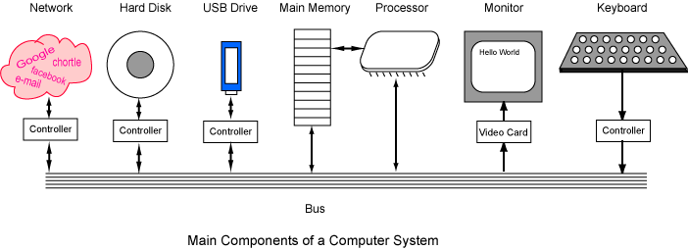
Components of a Computer Systems ...contd

Slide 10
Components of a Computer Systems …contd
The terms input and output say if data flow into or out of the computer.
The arrows show the direction of data flow.
A bus is a group of wires on the main circuit board of the computer.
Most devices are connected to the bus through a controller which coordinates the activities of the device with the bus.
The processor is an electronic device about a one inch square, covered in plastic. Inside the square is an even smaller square of silicon containing millions of tiny electrical parts. A modern processor may contain billions of transistors. It does the fundamental computing within the system, and directly or indirectly controls all the other components.
The processor is sometimes called the Central Processing Unit or CPU. A particular computer will have a particular type of processor, such as a Pentium processor or a SPARC processor

Slide 11
How computer systems works?
Video : To understand the work flow of the computer systems.
https://www.youtube.com/watch?v=AkFi90lZmXA

Slide 12

Just A Minute(JAM)
1) The brain of any computer system is
ALU
Memory
CPU
None of the above
2) A bus is
a group of wires on the main circuit board of the computer
a group of circuit on the main board of the computer
Wires connecting the monitor and CPU
None of the above
3) Processor
A hardware component used to store data
A software component used for connecting the hard ware and software
The processor performs all the fundamental computation of the computer system and it has relatively little memory
None of the above

Slide 13
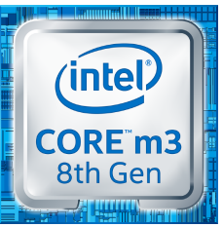
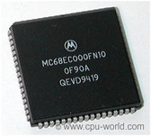
Processor
The processor performs all the fundamental computation of the computer system.
Other components contribute to the computation by doing such things as storing data or moving data into and out of the processor.
A processor chip has relatively little memory. It has only enough memory to hold a few instructions of a program and the data they process.
Examples:
4004 (4-bit processor)
8008,8080, 8085 ( 8-bit processor)
8086, 8088, 80286 (16-bit processor)
80386, 80486, Pentium, Pentium II/III, Intel Core, Dual Core (32-bit processor)
Core i3/i5/i7/i8/i9 (64-bit processor)

Slide 14
Input and Output Devices
Input Device | Out put devices
Keyboard Mouse Microphone Bar code reader | Monitor Printer Speaker

Slide 15
Software
Software is defined as a set of instructions that are processed by a computer system.
A software program is a collection of instructions that accomplish a task.
Software programs are written in programming languages such as C, C++, Java, C#, Python
Types of software
Application software
System software
System software includes the core components of the system that must be present in order for the computer to operate.
Application software is software used to assist users in performing typical office type work

Slide 16
Application and System Software Examples
Application Software | Systems Software
Word processors Games Spreadsheets Database systems Web browsers Notepad MS paint | Operating system Networking system Programming language software Web site server

Slide 17
What is an OS

Slide 18
Operating System
An Operating system or OS is a software program that enables the computer hardware to communicate and operate with the computer software.
Examples of computer operating systems
Microsoft Windows 7 or 10
Apple MacOS
Ubuntu Linux Google Android
iOS

Slide 19
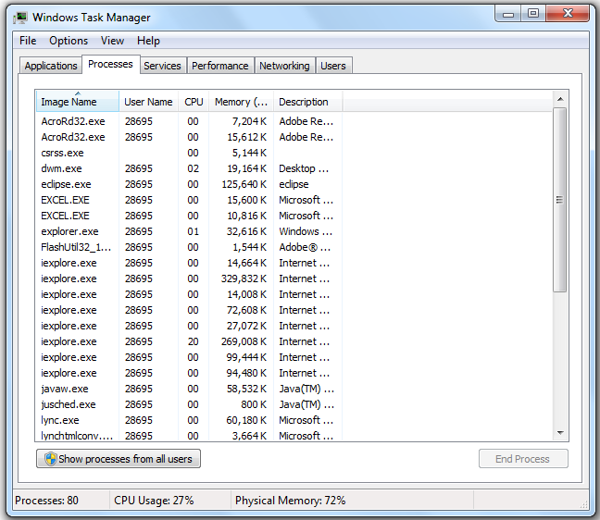
Processes & Processes Management
A process is a program in execution.
It contains the program code and its current activity.
Several processes may be associated with the same program; for example, opening up several instances of the same program often means more than one process is being executed
Stack
Data
Thread
Thread
Process
…
Stack
Program
Stack
Thread
Operating System

Slide 20
Processes Management
Process management is an integral part of any modern-day operating system (OS). The OS must allocate resources to processes, enable processes to share and exchange information, protect the resources of each process from other processes and enable synchronization among processes. To meet these requirements, the OS must maintain a data structure for each process, which describes the state and resource ownership of that process, and which enables the OS to exert control over each process

Slide 21
Processes Management
Program
A program by itself is not a process. It is a static entity made up of program statement while process is a dynamic entity. Program contains the instructions to be executed by processor.
A program takes a space at single place in main memory and continues to stay there. A program does not perform any action by itself.
Process States
As a process executes, it changes state. The state of a process is defined as the current activity of the process.
Process can have one of the following five states at a time

Slide 22
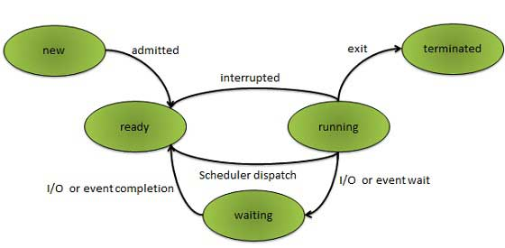
Processes States

Slide 23
Processes States
S.N. | State & Description
1 | New The process is being created.
2 | Ready The process is waiting to be assigned to a processor. Ready processes are waiting to have the processor allocated to them by the operating system so that they can run.
3 | Running Process instructions are being executed (i.e. The process that is currently being executed).
4 | Waiting The process is waiting for some event to occur (such as the completion of an I/O operation).
5 | Terminated The process has finished execution.

Slide 24
Gamification on Process Management
Game to get more clarity about Process management.

Slide 25
Memory Management
A memory is just like a human brain. It is used to store data and instructions.
Computer memory is the storage space in computer where data is to be processed and instructions required for processing are stored.
The memory is divided into large number of small parts called cells.
Each location or cell has a unique address which varies from zero to memory size minus one.
For example if computer has 64k words, then this memory unit has 64 * 1024=65536 memory locations.
The address of these locations varies from 0 to 65535.

Slide 26
Memory
Memory can be classified in to three fundamental types:
Main memory, and secondary memory and Cache memory
Main memory is sometimes called volatile because it looses its information when power is removed.
Secondary memory is usually nonvolatile because it retains its information when power is removed. (However, it needs power when information is stored into memory or retrieved from it.)
Main memory is sometimes called main storage and secondary memory is sometimes called secondary storage or mass storage
Cache Memory is a small storage area

Slide 27
Main Memory
closely connected to the processor.
stored data are quickly and easily changed.
holds the programs and data that the processor is actively working with.
interacts with the processor millions of times per second.
needs constant electric power to keep its information.

Slide 28
Secondary Memory
connected to main memory through the bus and a controller.
stored data are easily changed, but changes are slow compared to main memory.
used for long-term storage of programs and data.
before data and programs can be used, they must be copied from secondary memory into main memory.
does not need electric power to keep its information.

Slide 29
Primary Vs Secondary Memory
Primary memory | Secondary memory
Fast Expensive Low capacity Works directly with the processor | Slow Cheap Large capacity Not connected directly to the processor

Slide 30
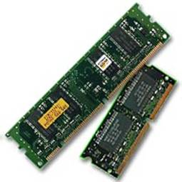
Primary Memory (Main Memory)
Primary memory holds only those data and instructions on which computer is currently working. It has limited capacity and data is lost when power is switched off.
It is generally made up of semiconductor device.
These memories are not as fast as registers.
The data and instruction required to be processed reside in main memory.
It is divided into two subcategories RAM and ROM.
Characteristics of Main Memory
These are semiconductor memories
It is known as main memory.
Usually volatile memory.
Data is lost in case power is switched off.
It is working memory of the computer.
Faster than secondary memories.
A computer cannot run without primary memory.

Slide 31
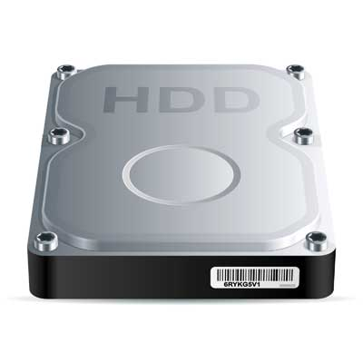
Secondary Memory
This type of memory is also known as external memory or non-volatile.
It is slower than main memory.
These are used for storing data/Information permanently.
CPU directly does not access these memories instead they are accessed via input-output routines.
Contents of secondary memories are first transferred to main memory, and then CPU can access it.
For example : disk, CD-ROM, DVD etc
Characteristic of Secondary Memory
These are magnetic and optical memories
It is known as backup memory.
It is non-volatile memory.
Data is permanently stored even if power is switched off.
It is used for storage of data in a computer.
Computer may run without secondary memory.
Slower than primary memories

Slide 32
Stack and Heap
Stack:
Stored in computer RAM just like the heap.
Variables created on the stack will go out of scope and automatically de allocate.
Much faster to allocate in comparison to variables on the heap.
Implemented with an actual stack data structure.
Stores local data, return addresses, used for parameter passing
Can have a stack overflow when too much of the stack is used. (mostly from infinite (or too much) recursion, very large allocations)
Data created on the stack can be used without pointers.
You would use the stack if you know exactly how much data you need to allocate before compile time and it is not too big.
Usually has a maximum size already determined when your program starts

Slide 33
Stack and Heap
Heap:
Stored in computer RAM just like the stack.
Variables on the heap must be destroyed manually and never fall out of scope. The data is freed with delete, delete[] or free
Slower to allocate in comparison to variables on the stack.
Used on demand to allocate a block of data for use by the program.
Can have fragmentation when there are a lot of allocations and deallocations
In C++ data created on the heap will be pointed to by pointers and allocated with new or malloc
Can have allocation failures if too big of a buffer is requested to be allocated.
You would use the heap if you don't know exactly how much data you will need at runtime or if you need to allocate a lot of data.
Responsible for memory leaks

Slide 34
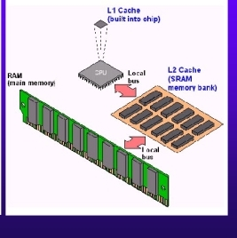
Cache Memory
Cache memory, also called CPU memory.
Cache is random access memory (RAM) that a computer microprocessor can access more
quickly than it can access regular RAM.
As the microprocessor processes data, it looks first in the cache
memory and if it finds the data there
(from a previous reading of data), it does not have to do the
more time-consuming reading of data
from larger memory.
Cache memory is fast and it is expensive.

Slide 35
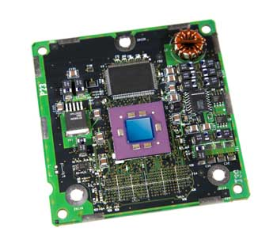
Cache Memory
Cache memory is a very high-speed semiconductor memory which can speed up CPU.
It acts as a buffer between the CPU and main memory.
It is used to hold those parts of data and program which are most frequently used by CPU.
The parts of data and programs are transferred from disk to cache memory by operating system, from where CPU can access them.

Slide 36
Advantages and Disadvantages of Cache Memory
The advantages and disadvantages of cache memory are as follows
Advantages
Cache memory is faster than main memory.
It consumes less access time as compared to main memory.
It stores the program that can be executed within a short period of time.
It stores data for temporary use
Disadvantages
Cache memory has limited capacity.
It is very expensive.

Slide 37
Register
A register is a local storage space on a processor that holds data that is being processed by CPU. Processor registers generally occupy the top-most position in the memory hierarchy, providing high-speed storage space and fast access to data. A register may include the address of the memory location instead of the real data itself
Every processor has a local storage area known as a register
Processor registers can be classified into general-purpose and special-purpose registers
General-purpose registers temporarily store data that is being processed by the CPU

Slide 38
Cache vs Register
Accessing registers is faster and more efficient than accessing cache.
cache can contain instruction code whereas registers cannot
Machine instructions are not stored in registers
In multiple core processors, registers share a common cache.

Slide 39
JAM
1) Any type of storage that is used for holding information between steps in its processing is
CPU
Primary Storage
Intermediate Storage
Internal Storage
None of the above

Slide 40
JAM
2) Virtual memory is
Inside the Ram
Inside the processor
It is logical
None of the above

Slide 41
JAM
1) Cache memory has limited capacity.
True
False
2) Which are the lines True about main Memory
closely connected to the processor
1) needs constant electric power to keep its information.
2) used for long-term storage of programs and data.
3) All the above
4) None of the above
Answer:
1 and 2
1 and 3
2 and 3

Slide 42
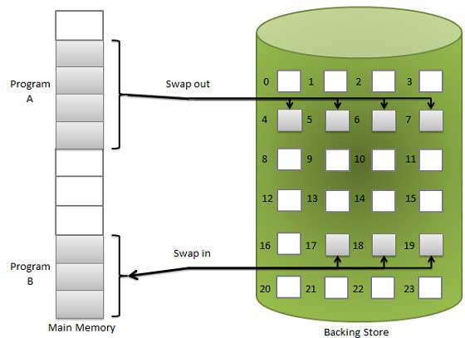
Virtual Memory
Virtual memory is a technique that allows the execution of processes which
are not completely available in memory.
This separation allows an extremely large virtual memory to be provided for programmers when only a smaller physical memory is available.
Virtual memory is commonly implemented by demand paging
A demand paging system is quite similar to a paging system with swapping.
When a process is to be swapped in, the pager guesses which pages
will be used before the process is swapped out again. Instead of swapping in a whole process, the pager brings only those necessary pages into memory.
It avoids reading into memory pages that will not be used in anyway, decreasing the swap time and the amount of physical memory needed

Slide 43
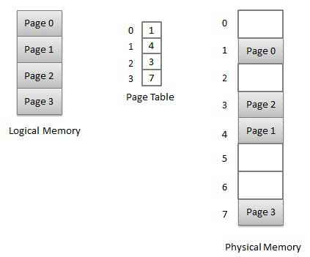
Memory Management
Memory management is the act of managing computer memory.
Memory management is to provide ways to dynamically allocate portions of memory
Virtual memory systems separate the memory addresses used by a process from actual physical addresses
The concept of a logical address space that is bound to a separate
physical address space is central to proper memory management.
Logical address – generated by the CPU; also referred to as virtual address
Physical address – address seen by the memory unit
Logical and physical addresses are the same in compile-time and load time
address-binding schemes; logical (virtual) and physical addresses differ in
execution-time address-binding scheme

Slide 44

JAM
Which is fastest? Main memory or secondary memory?

Slide 45

JAM
1) Where is the program you are running Where is the program you are running.
In main memory or In Secondary memory ?
2) Running programs are always located in main memory.

Slide 46
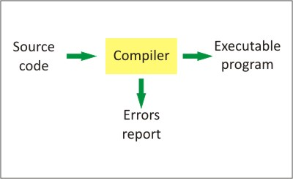
Compiler and Interpreter
A compiler is a computer program that transforms source code written in a programming language into another computer language
Compilers are a specific type of translators.
A program that translates from a low-level language to a higher level one is a decompiler.
A program that translates between high-level languages is usually called a
source-to-source compiler or transpiler.
A language rewriter is usually a program that translates the form of expressions without a change of language.

Slide 47
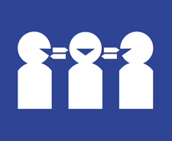
Compiler and Interpreter ..contd
In computer science, an interpreter is a computer program that directly executes,
i.e. performs, instructions written in a programming or scripting language,
without previously compiling them into a machine language program.
An interpreter generally uses one of the following strategies for program execution:
1) Parse the source code and perform its behavior directly
2) Translate source code into some efficient intermediate representation and immediately execute this
3) Explicitly execute stored precompiled code made by a compiler which is part of the interpreter system

Slide 48
Compiler and Interpreter …contd
Compiler | Interpreter
Compiler Takes Entire program as input | Interpreter Takes Single instruction as input .
Intermediate Object Code is Generated | No Intermediate Object Code is Generated
Conditional Control Statements are Executes faster | Conditional Control Statements are Executes slower
Memory Requirement : More (Since Object Code is Generated) | Memory Requirement is Less
Program need not be compiled every time | Every time higher level program is converted into lower level program
Errors are displayed after entire program is checked | Errors are displayed for every instruction interpreted (if any)
Example : C Compiler | Example : BASIC

Slide 49
JAM
1) Which are the statements are true about compiler
Statement 1: Compiler Takes Entire program as input
Statement 2: No Intermediate Object Code is generated
Statement 3: Conditional Control Statements are Executes Faster Conditional Control Statements are Executes faster
Answer:
1) Statement 1, Statement 2 ,Statement 3
2) Statement 1, Statement 2,
3) Statement 1, Statement 3
4) Statement 2, Statement 3
5) None of the above

Slide 50
JAM
1) Interpreter is known as
Language translator
Assembler
Firewall
Hardware
2) A computer program that converts assembly language to machine language is
Compiler
Interpreter
Assembler
Comparator

Slide 51
Computer Network
A computer network or data network is a telecommunications network that allows computers to exchange data.
In computer networks, networked computing devices pass data to each other along data connections.
Data is transferred in the form of packets.
The connections (network links) between nodes are established using either cable media or wireless media.

Slide 52
Types of Networks
Local Area Network (LAN)
Small Network
Usually confined to a building or an office floor
Wide Area Network (WAN)
Two or more LANs connected together
The Internet is an example
Metropolitan Area Network (MAN)
Covers a large area, such as a city

Slide 53
Network Components
Repeaters
Used to amplify data signals due to attenuation
Hubs
Act as a concentrator to connect several computers
Switches
Intelligent hubs that segment traffic to avoid collisions
Routers
Must have to be able to access the Internet

Slide 54
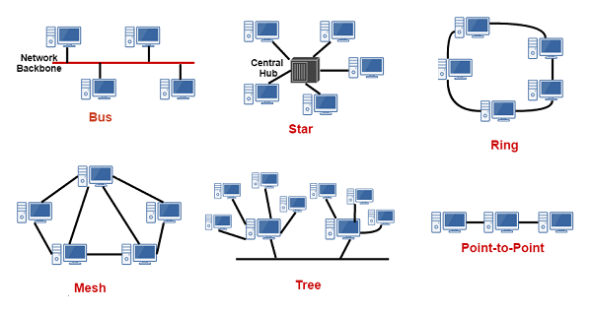
Network Topology
Network Topology is the arrangement with which computer systems or network devices are connected to each other
Various Topologies are,
Bus
Ring
Star
Mesh
Tree
Point to point

Slide 55
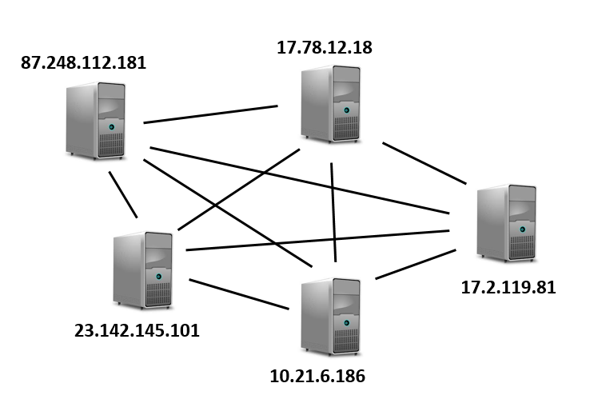
IP Address
Internet Protocol (IP) address is a numerical label assigned to each device connected to a computer network
IP address has two parts: host or network interface identification and location addressing
Two versions of the Internet Protocol (IP) are in common today.
Internet Protocol version 4 (IPv4) - 32 bits
Internet Protocol Version 6 (IPv6) - 128 bits
Example: 192.168.1.24
4 decimal numbers separated by dots, each one of the four numbers is 8 bit or 1 byte in size and ranges from 0 to 255

Slide 56
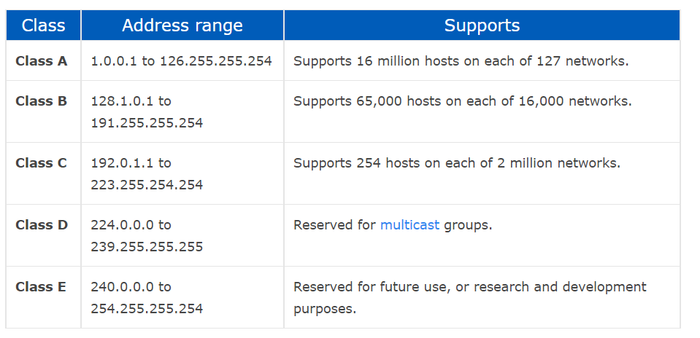
Classes of IP Networks
There are 5 classes of IP addresses.
Class A, Class B, Class C, Class D and Class E
Class A, B, and C are commonly used, class D is used for multicast and Class E is used for R&D purpose

Slide 57
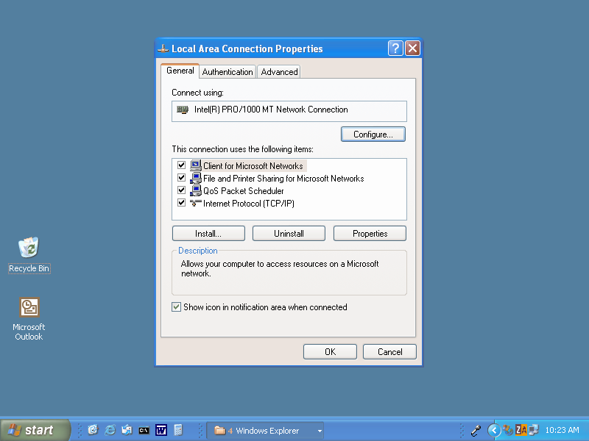
Protocol
A network protocol is a set of established rules that dictates how to format, transmit and receive data so computer network devices
Can think of a protocol as a spoken language and it has own rules and vocabulary
If two hardware devices support the same protocol, they can communicate with each other seamlessly

Slide 58
Protocol Examples
TCP/IP
UDP
SMTP
FTP
HTTP
Let us see how our data packets travel from the source to destination through the internet.
https://www.youtube.com/watch?v=O7CuFlM4V54

Slide 59

Internet
The Internet consists of many networks that have been connected together to form one huge worldwide network.
Even on this huge network, each computer must have a unique network address, called an IP address, much like each telephone in the world has a unique telephone number (including the country code and area code).

Slide 60

Uses Of Internet
Research
Communication
Shopping
Leisure and Entertainment
Exploring the world
Education etc…

Slide 61
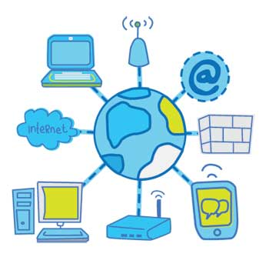
Uses Of Internet
It is a worldwide system which has the following characteristics:
Internet is a world-wide / global system of interconnected computer networks.
Internet uses the standard Internet Protocol (TCP/IP)
Every computer in internet is identified by a unique IP address.
IP Address is a unique set of numbers (such as 110.22.33.114) which identifies a computer’s location.
A special computer DNS (Domain Name Server) is used to give name to the IP Address so that user can locate a computer by a name.
Internet is accessible to every user all over the world.

Slide 62
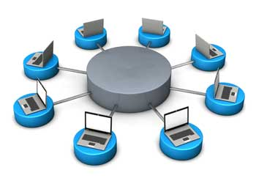
Intranet
Intranet is system in which multiple PCs are connected to each other.
PCs in intranet are not available to the world outside the intranet.
Usually each company or organization has their own Intranet network and members/employees of that company can access the computers in their intranet.
Each computer in Intranet is also identified by an IP Address which is unique among the computers in that Intranet.

Slide 63
Internet Vs Intranet
Similarities in Internet and Intranet
Intranet uses the internet protocols such as TCP/IP and FTP.
Intranet sites are accessible via web browser in similar way as websites in internet. But only members of Intranet network can access intranet hosted sites.
In Intranet, own instant messengers can be used as similar to yahoo messenger/ Gtalk over the internet
Differences in Internet and Intranet
Internet is general to PCs all over the world whereas Intranet is specific to few PCs.
Internet has wider access and provides a better access to websites to large population whereas Intranet is restricted.
Internet is not as safe as Intranet as Intranet can be safely privatized as per the need.

Slide 64
How Data travels through Network ?
https://www.youtube.com/watch?v=O7CuFlM4V54

Slide 65
System Computing
Serial computing
Parallel computing
Concurrent computing
Distributed computing

Slide 66
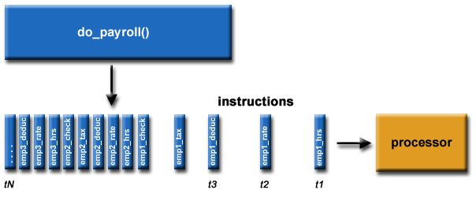
Serial computing
Traditionally, software has been written for serial computation:
A problem is broken into a discrete series of instructions
Instructions are executed sequentially one after another
Executed on a single processor
Only one instruction may execute at any moment in time
Serial Computing

Slide 67
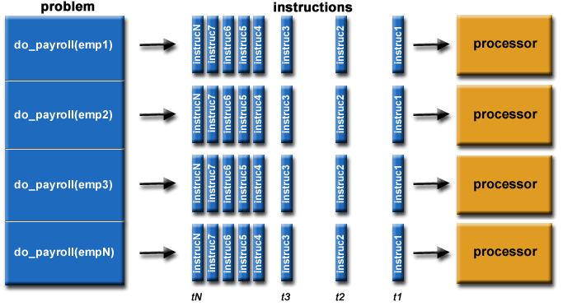
Parallel Computing:
In the simplest sense, parallel computing is the simultaneous use of multiple compute resources to solve a computational problem:
A problem is broken into discrete parts that can be solved concurrently
Each part is further broken down to a series of instructions
Instructions from each part execute simultaneously on different processors
An overall control/coordination mechanism is employed

Slide 68
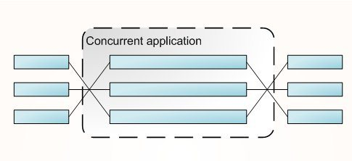
Concurrent Computing
The different processes can execute on different computers in a multiprocessing system. Thus computation may be speeded up.
As an example consider a checkers-playing application that evaluates different board positions. Each board position could be evaluated by a different process running on a different computer.
Similarly, independent animations can be executed concurrently by different processors.

Slide 69
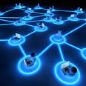
Distributed Computing
A distributed computing is a system in which components located on networked computers communicate and coordinate their actions by passing messages. The components interact with each other in order to achieve a common goal.

Slide 70
JAM
Traditionally, software has been written
parallel computation
distributed computation
serial computation
concurrent computing
None of the above

Slide 71
Malicious code
Malicious Code is the term used to describe any code in any part of a software system or script that is intended to cause undesired effects, security breaches or damage to a system.
Malicious Code is an application security threat.

Slide 72

Virus
A virus is a man-made computer program that infects a file or program on our computers.
A computer virus attaches itself to a program or file enabling it to spread from one computer to another, leaving infections as it travels. Almost all viruses are attached to an executable files,
Virus spread by human action
When we share infected files or sending emails with virus attached files
.

Slide 73

Worms
Worms spread from computer to computer
Worms has the capability to travel without any human action.
A worm takes advantage of file or information transport features on your system, which is what allows it to travel unaided.
Worm has the capability to replicate itself on your system,
Due to the copying nature of a worm and its capability to travel across networks the end result in most cases is that the worm consumes too much system memory

Slide 74
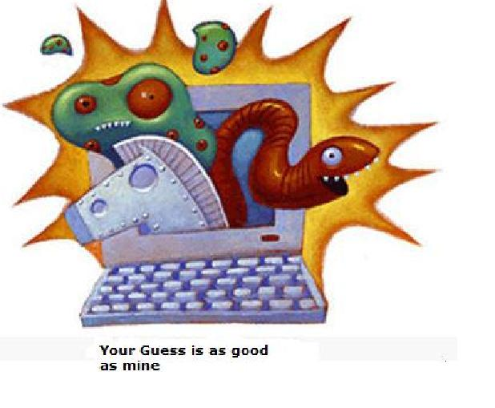
Trojan horse
The Trojan Horse, at first glance will appear to be useful software but will actually do damage once installed or run on your computer. Those on the receiving end of a Trojan Horse are usually tricked into opening them because they appear to be receiving legitimate software or files from a legitimate source. When a Trojan is activated on your computer, the results can vary.
Trojans are designed to be more annoying than malicious (like changing your desktop, adding silly active desktop icons) or they can cause serious damage by deleting files and destroying information on your system. Trojans do not reproduce by infecting other files nor do they self-replicate.

Slide 75
Antivirus
Antivirus or anti-virus software (often abbreviated as AV), sometimes known as anti-malware software, is computer software used to prevent, detect and remove malicious software
Antivirus software was originally developed to detect and remove computer virus.
Modern antivirus software can protect from: malicious Browser Helper Objects, browser hijackers, Trojan horses, worms, Some products also include protection from other computer threats, such as infected and malicious URLs, spams, scam and phishing attacks, online identity (privacy), online banking attacks techniques, Advanced Persistent Threat (APT), botnets DDoS attacks.[2]

Slide 76
How to prevent computers from different Malicious forms?
We will get the answer for the above question by watching the video given in the below url.
https://www.youtube.com/watch?v=7PVwCHBOqZM
https://www.youtube.com/watch?v=c34QwtYI40g&nohtml5=False

